Slide 1

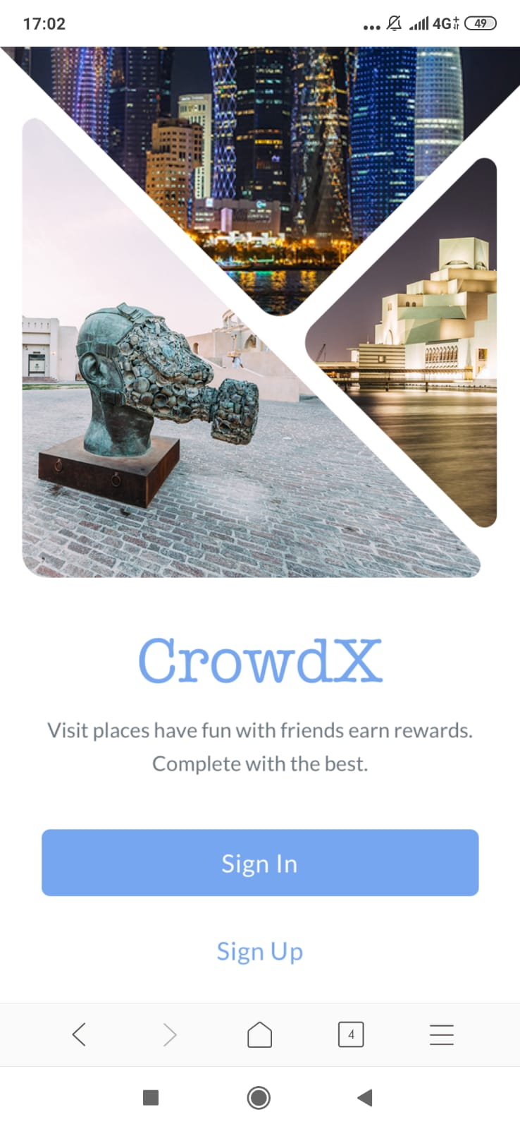

Enhancing Fan experience
CrowdX

Slide 2

Solution
CrowdX
Target
Exposure to the Qatari culture and heritage.
Stimulate transportations and recreational services.
Crowd Management.
Provide list of all Venues and Attractions.
Compete with friends & Earn Rewards For FREE!
Target Specific Places for the Fans to move. Interactive MAP!

Slide 3
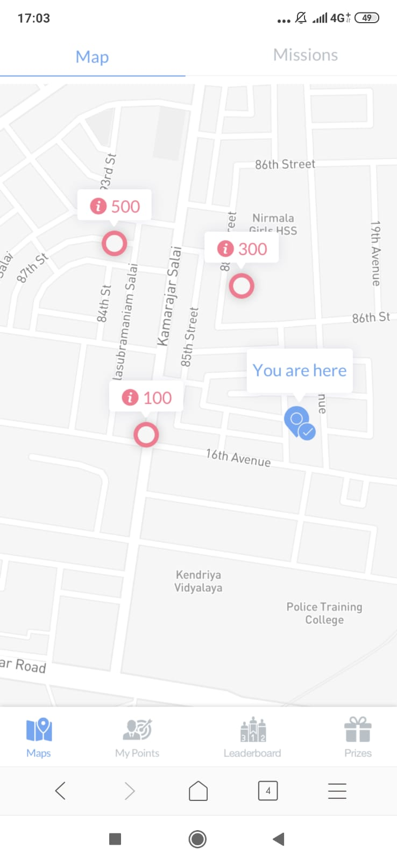
Interactive Maps
Product
Real time Missions
Fun Competition

Slide 4






Rewards
Gift Cards
Souvenirs
T-shirts
Discounts
And More..

Slide 5
Thank You!
CrowdX

